Slide 1
Data Engineering Final Exam
Jelle Smet &
Xander Aerts
Thomas More
Applied Data Intelligence

Slide 2
TABLE OF CONTENTS
01
03
02
04
PROBLEM SETTING
DATA LAYER 1: RAW LAYER
General Information
General Information
Approach
Approach & Implementation
DATA LAYER 2: BRONZE LAYER
General Approach
General Information
Approach

Slide 3
TABLE OF CONTENTS
05
07
06
08
DATA LAYER 3: SILVER LAYER
PROJECT VISUALIZATION
General Information
Approach
Mandatory plots
Extra Plots
DATA LAYER 4: GOLD LAYER
Findings & Conclusions
General Information
Approach
Reflection (Personal)
Reflection (Team)

Slide 4
TABLE OF CONTENTS
01
03
02
04
PROBLEM SETTING
DATA LAYER 1: RAW LAYER
General Information
General Information
Approach
Approach & Implementation
DATA LAYER 2: BRONZE LAYER
General Approach
General Information
Approach

Slide 5
01
PROBLEM SETTING
General Information

Slide 6
General Information
How much revenue did we generate this year?
Revenue Breakdown by
Products
Customers
Order Statuses
Geography

Slide 7
TABLE OF CONTENTS
01
03
02
04
PROBLEM SETTING
DATA LAYER 1: RAW LAYER
General Information
General Information
Approach
Approach & Implementation
DATA LAYER 2: BRONZE LAYER
General Approach
General Information
Approach

Slide 8
02
Approach & Implementation
General Approach

Slide 9
General Approach
1
2
3
Raw Layer
Bronze Layer
Silver Layer
5
4
Visualization
Gold Layer

Slide 10
General Approach
Raw Layer
Bronze Layer
Silver Layer
Checking & understanding
Cleaning & Standardizing
Structuring & Enriching
Visualization
Gold Layer
Visualizing & Concluding
Aggregating for insights

Slide 11
TABLE OF CONTENTS
01
03
02
04
PROBLEM SETTING
DATA LAYER 1: RAW LAYER
General Information
General Information
Approach
Approach & Implementation
DATA LAYER 2: BRONZE LAYER
General Approach
General Information
Approach

Slide 12
03
DATA LAYER 1: RAW LAYER
General Information
Approach

Slide 13
General Information & Approach
1
2
3
Read Files
Understand Files
Find Relationships

Slide 14
TABLE OF CONTENTS
01
03
02
04
PROBLEM SETTING
DATA LAYER 1: RAW LAYER
General Information
General Information
Approach
Approach & Implementation
DATA LAYER 2: BRONZE LAYER
General Approach
General Information
Approach

Slide 15
04
DATA LAYER 2: BRONZE LAYER
General Information
Approach

Slide 16
General Information
1
2
3
Setup Environment
Initialize Spark
Process Data
5
4
Stop Spark
Display Schema

Slide 17
General Approach
Setup Environment
Initialize Spark
Process Data
Configure directions and initialized logging
Created a SparkSession for Data Processing
Read Files, Add Ingestion TS, Handle corrupt records, Converted to Parquet Files
Stop Spark
Display Schema
Terminated the SparkSession
Printed the schema of the last processed DataFrame

Slide 18
05
DATA LAYER 3: SILVER LAYER
General Information
Approach

Slide 19
General Information
1
2
3
Setup Environment
Initialize Spark
Define DQ Functions
6
5
4
Stop Spark
Generate DQ Report
Process Tables

Slide 20
General Approach
Setup Environment
Initialize Spark
Define DQ Functions
Configure directions and initialized logging
Created a SparkSession for the Silver Layer
Created reusable data quality functions
Stop Spark
Generate DQ Report
Process Tables
Terminated the SparkSession
Created a SparkSession for Data Processing
Transformed and cleaned Bronze data, then saved to Silver (Parquet)

Slide 21
TABLE OF CONTENTS
05
07
06
08
DATA LAYER 3: SILVER LAYER
PROJECT VISUALIZATION
General Information
Approach
Mandatory Plots
Extra Plots
DATA LAYER 4: GOLD LAYER
Findings & Conclusions
General Information
Approach
Reflection (Personal)
Reflection (Team)

Slide 22
06
DATA LAYER 4: GOLD LAYER
General Information
Approach

Slide 23
General Information
1
2
3
Setup & Spark
Define Utilities
Implement SCD / Upsert
6
5
4
Build Analysis Table
Create Fact Table
Create Dimensions

Slide 24
General Approach
Setup & Spark
Define Utilities
Implement SCD / Upsert
Environment configured, Spark started.
Creating helper unctions.
Logic for data versioning and updates.
Build Analysis Table
Create Fact Table
Create Dimensions
Combined all data for revenue analysis.
Constructed and loaded the sales fact.
Built and loaded dimensions tables.

Slide 25
TABLE OF CONTENTS
05
07
06
08
DATA LAYER 3: SILVER LAYER
PROJECT VISUALIZATION
General Information
Approach
Mandatory Plots
Extra Plots
DATA LAYER 4: GOLD LAYER
Findings & Conclusions
General Information
Approach
Reflection (Personal)
Reflection (Team)

Slide 26
07
PROJECT VISUALIZATION
Mandatory Plots
Extra Plots

Slide 27
Mandatory Plots
1
2
3
Revenue By Category
Top 10 Subcategories
Top 10 Customers
6
5
4
Top 10 States Revenue
Top 10 Countries Revenue
Revenue by Order Status
7
Top 10 Cities Revenue

Slide 28
1
Revenue By Category
Category Revenue percentage share:
Bikes → 86,1%
Components → 10,7%
Clothes → 1,9%
Accessories → 1,1%

Slide 29
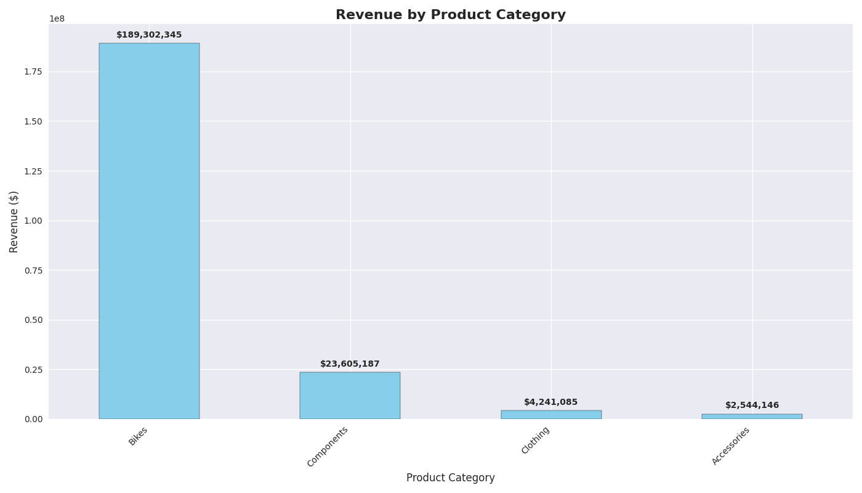
A PICTURE IS WORTH A THOUSAND WORDS

Slide 30
Mandatory Plots
1
2
3
Revenue By Category
Top 10 Subcategories
Top 10 Customers
6
5
4
Top 10 States Revenue
Top 10 Countries Revenue
Revenue by Order Status
7
Top 10 Cities Revenue

Slide 31
2
Top 10 Subcategories
Subcategory Revenue percentage share:
Road Bikes → 41,0%
Mountain Bikes → 34,0%
Touring Bikes → 13,3%
…

Slide 32
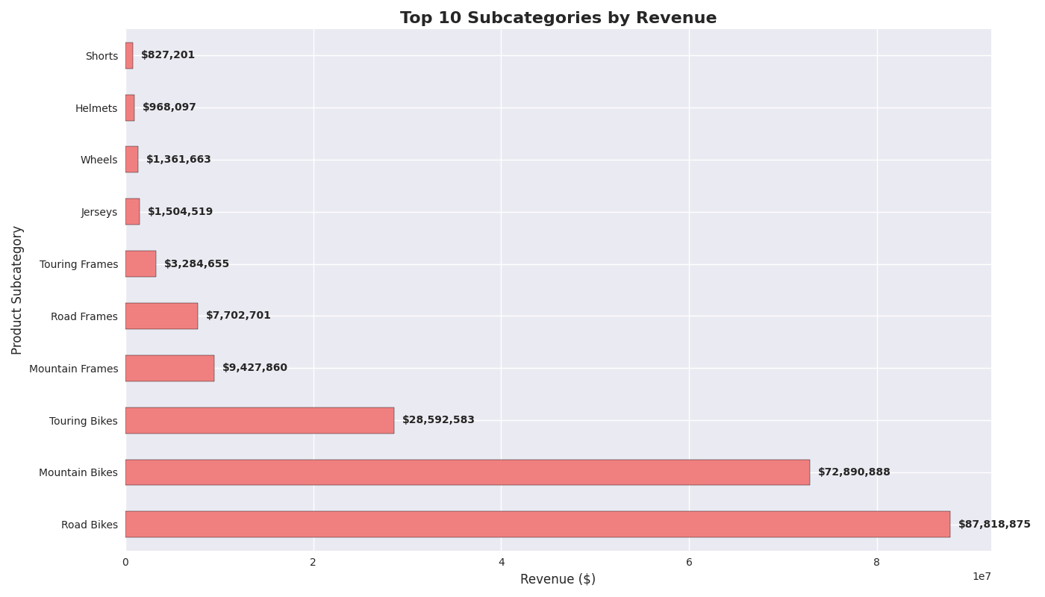
A PICTURE IS WORTH A THOUSAND WORDS

Slide 33
Mandatory Plots
1
2
3
Revenue By Category
Top 10 Subcategories
Top 10 Customers
6
5
4
Top 10 States Revenue
Top 10 Countries Revenue
Revenue by Order Status
7
Top 10 Cities Revenue

Slide 34
3
Top 10 Customers
Customer Revenue percentage share:
Roger Marui → 11,1%
Andrew Dixon → 10,8%
Reuben D’sa → 10,6%
…

Slide 35
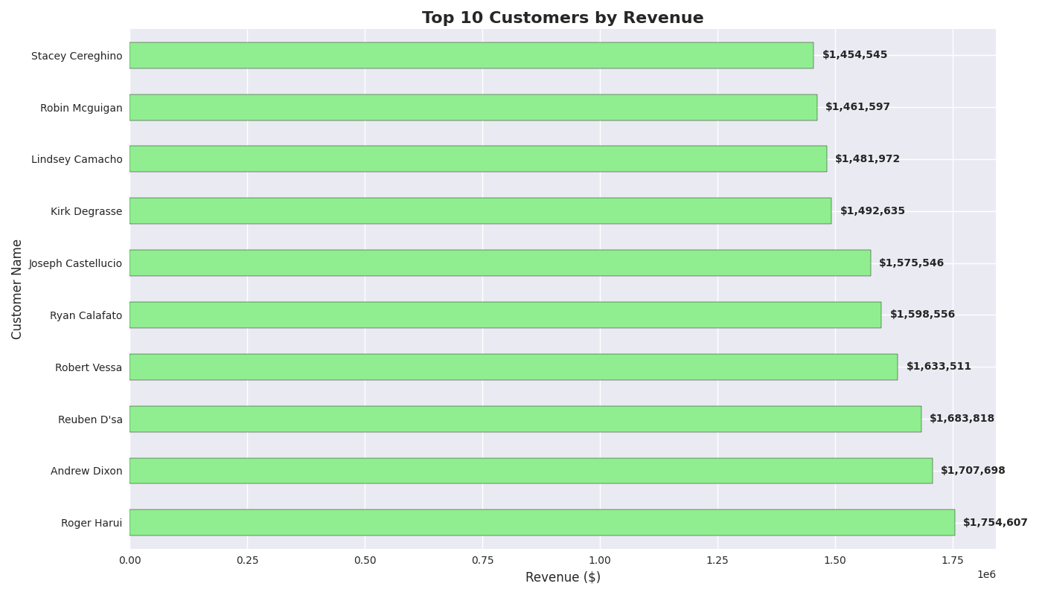
A PICTURE IS WORTH A THOUSAND WORDS

Slide 36
Mandatory Plots
1
2
3
Revenue By Category
Top 10 Subcategories
Top 10 Customers
6
5
4
Top 10 States Revenue
Top 10 Countries Revenue
Revenue by Order Status
7
Top 10 Cities Revenue

Slide 37
4
Revenue by Order Status
Order Status Revenue percentage share:
Shipped → 100%

Slide 38
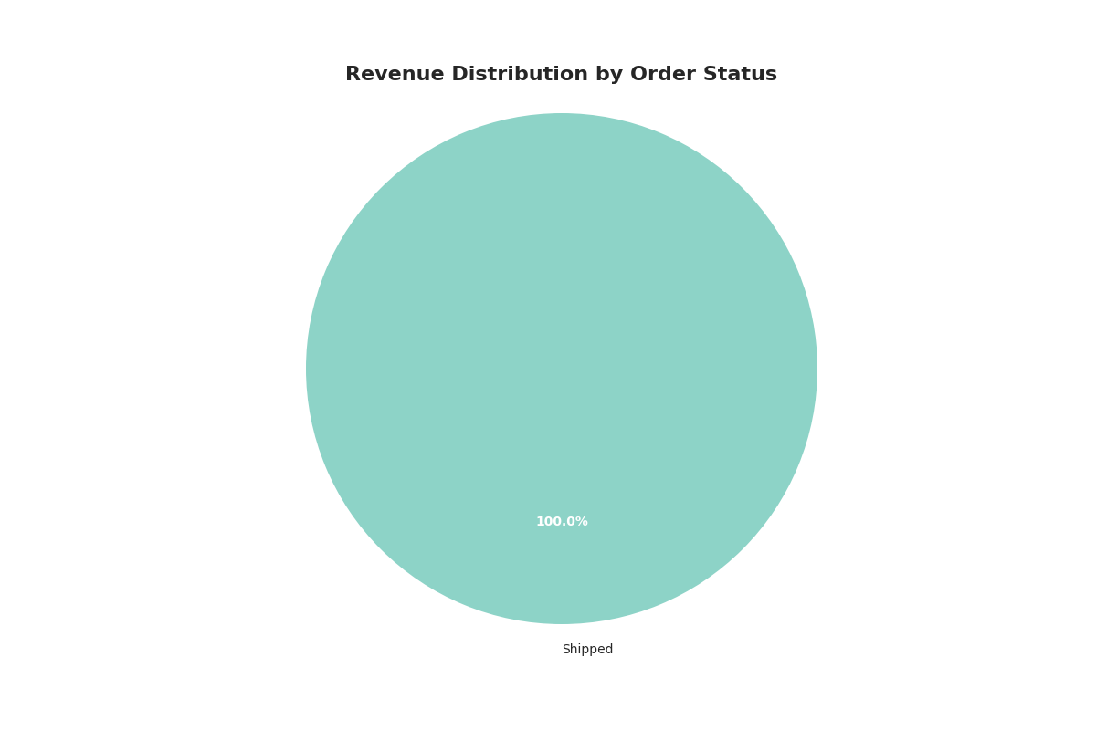
A PICTURE IS WORTH A THOUSAND WORDS

Slide 39
Mandatory Plots
1
2
3
Revenue By Category
Top 10 Subcategories
Top 10 Customers
6
5
4
Top 10 States Revenue
Top 10 Countries Revenue
Revenue by Order Status
7
Top 10 Cities Revenue

Slide 40
5
Top 10 Countries Revenue
Country Revenue percentage share:
United States → 61,9%
Canada → 10,5%
United Kingdom → 7,6%
…

Slide 41
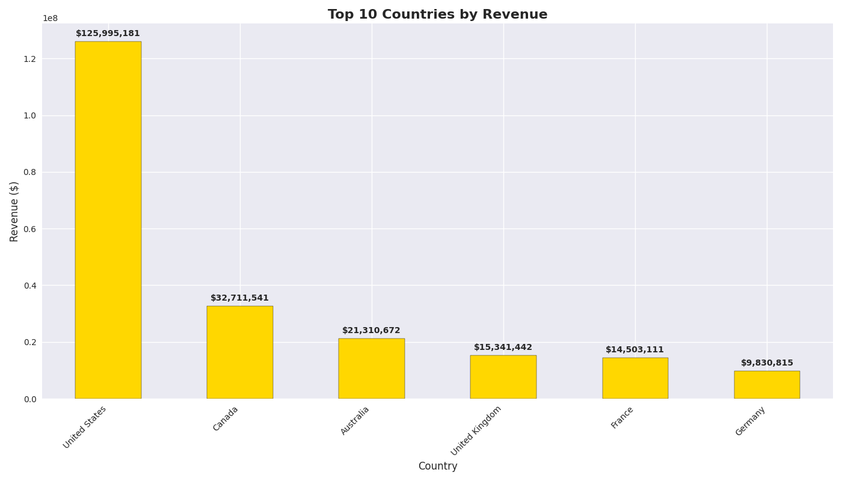
A PICTURE IS WORTH A THOUSAND WORDS

Slide 42
Mandatory Plots
1
2
3
Revenue By Category
Top 10 Subcategories
Top 10 Customers
6
5
4
Top 10 States Revenue
Top 10 Countries Revenue
Revenue by Order Status
7
Top 10 Cities Revenue

Slide 43
6
Top 10 States Revenue
State Revenue percentage share:
California → 29,3%
Washington → 17,8%
England → 14,5%
…

Slide 44
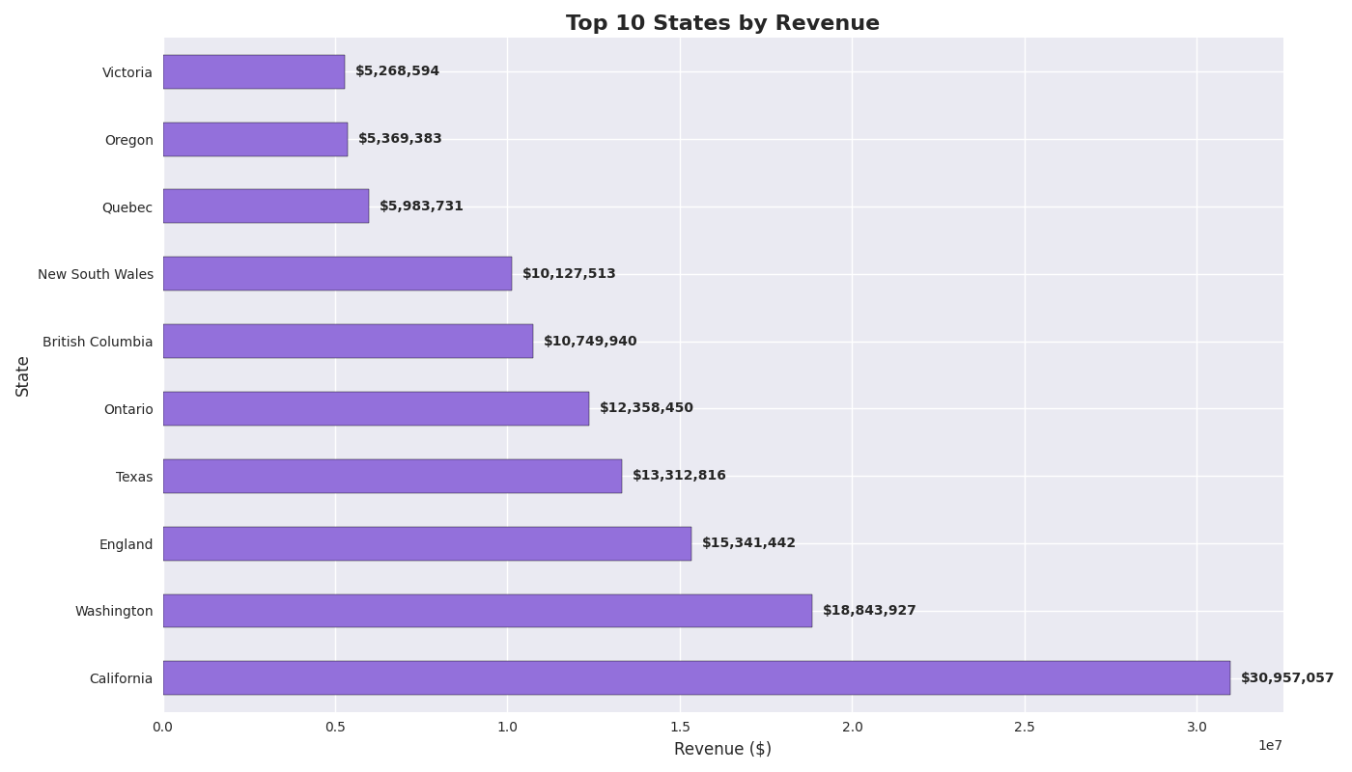
A PICTURE IS WORTH A THOUSAND WORDS

Slide 45
Mandatory Plots
1
2
3
Revenue By Category
Top 10 Subcategories
Top 10 Customers
6
5
4
Top 10 States Revenue
Top 10 Countries Revenue
Revenue by Order Status
7
Top 10 Cities Revenue

Slide 46
7
Top 10 Cities Revenue
Cities Revenue percentage share:
Toronto → 20,0%
London → 12,2%
Paris → 8,9%
…

Slide 47
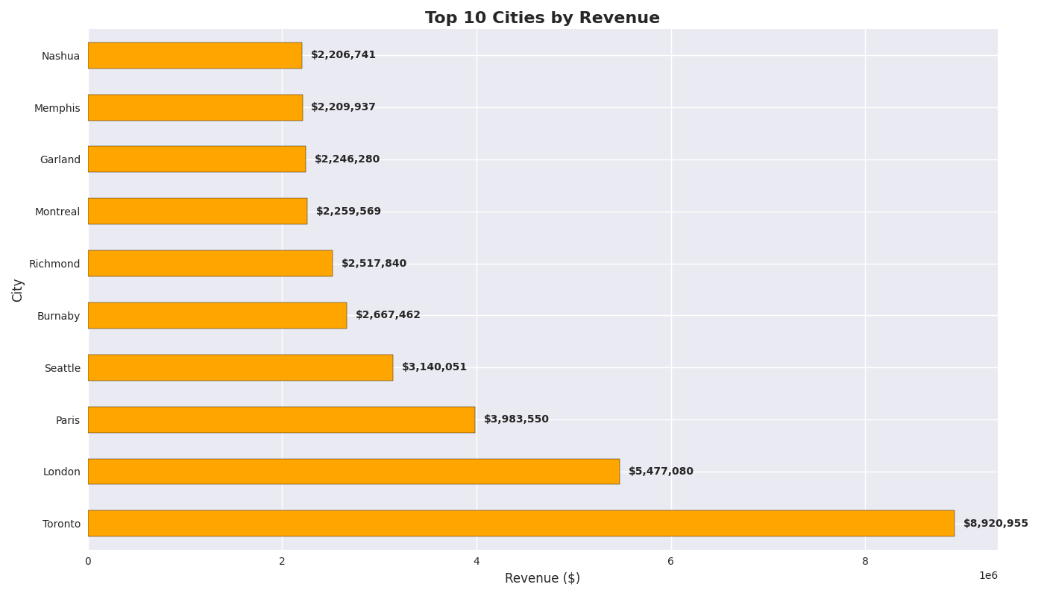
A PICTURE IS WORTH A THOUSAND WORDS

Slide 48
TABLE OF CONTENTS
05
07
06
08
DATA LAYER 3: SILVER LAYER
PROJECT VISUALIZATION
General Information
Approach
Mandatory Plots
Extra Plots
DATA LAYER 4: GOLD LAYER
Findings & Conclusions
General Information
Approach
Reflection (Personal)
Reflection (Team)

Slide 49
07
PROJECT VISUALIZATION
Mandatory Plots
Extra Plots

Slide 50
Extra Plots
1
2
3
Monthly Revenue trend
Revenue By Quarter
Territory Performance
5
4
Customer Type Analysis
Product performance Matrix

Slide 51
1
Monthly Revenue trend
Revenue evolution:
Overall positive evolution
Dropping tail

Slide 52
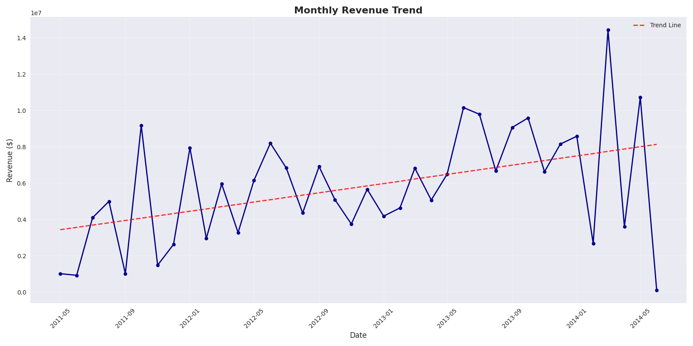
A PICTURE IS WORTH A THOUSAND WORDS

Slide 53
Extra Plots
1
2
3
Monthly Revenue trend
Revenue By Quarter
Territory Performance
5
4
Customer Type Analysis
Product performance Matrix

Slide 54
2
Revenue By Quarter
Quarter Revenue percentage share:
Quarter 1 → 27,3%
Quarter 2 → 26,1%
Quarter 3 → 25,2%
Quarter 4 → 24,4%

Slide 55
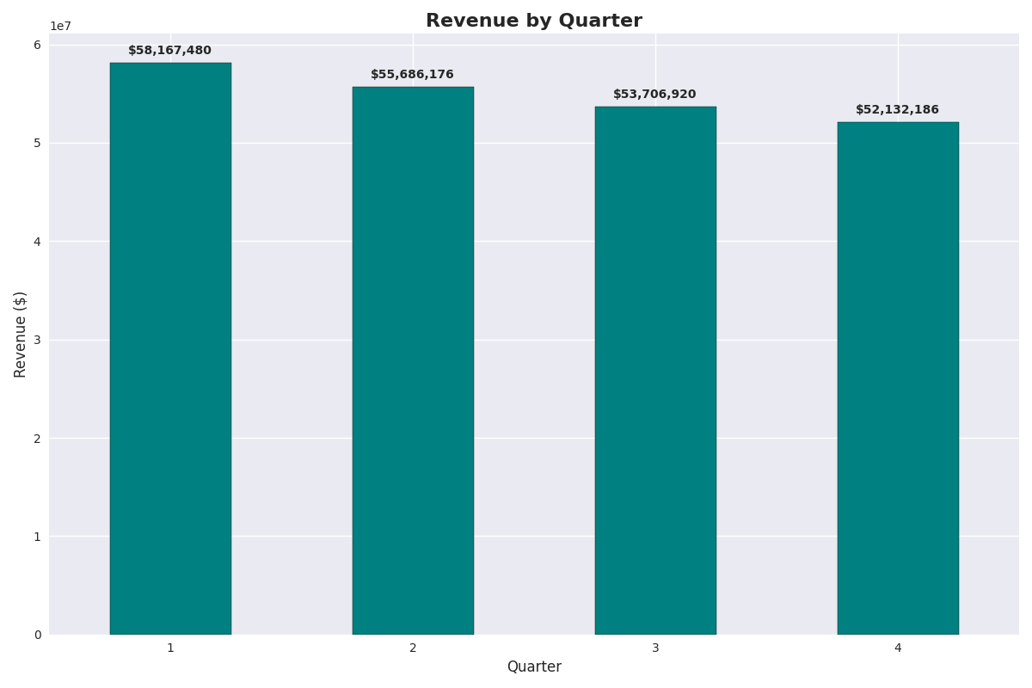
A PICTURE IS WORTH A THOUSAND WORDS

Slide 56
Extra Plots
1
2
3
Monthly Revenue trend
Revenue By Quarter
Territory Performance
5
4
Customer Type Analysis
Product performance Matrix

Slide 57
3
Territory Performance
Territory percentage share:
Southwest → 22,0%
Canada → 14,9%
Northwest → 14,6%

Slide 58
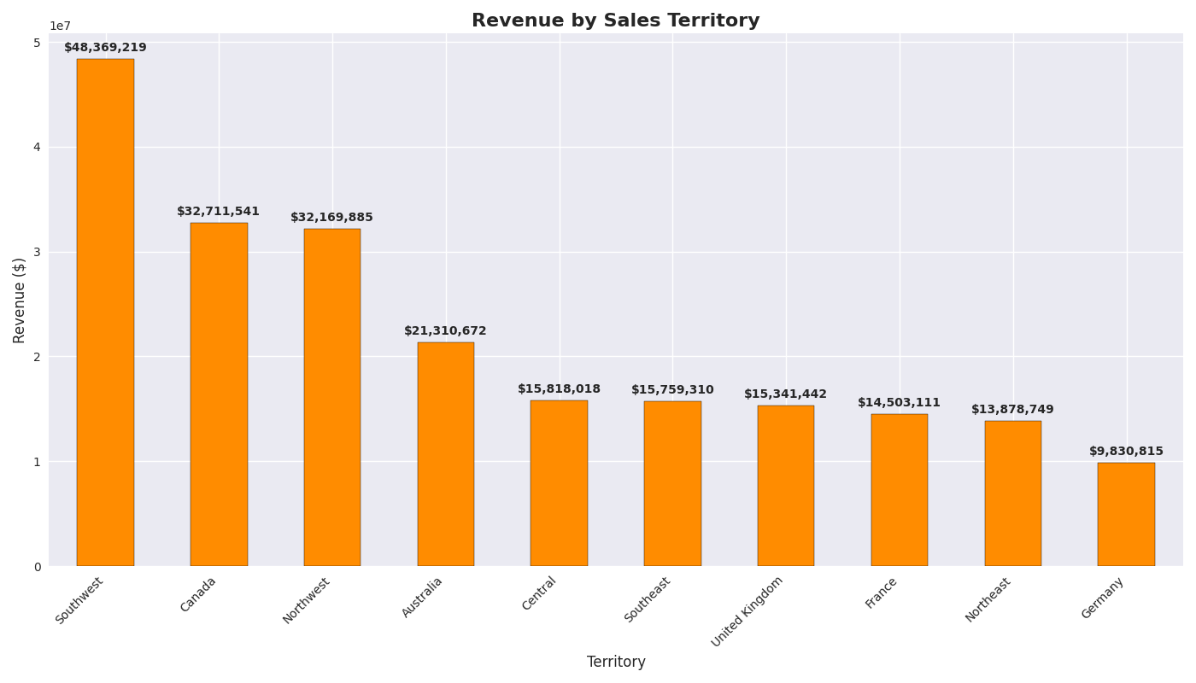
A PICTURE IS WORTH A THOUSAND WORDS

Slide 59
Extra Plots
1
2
3
Monthly Revenue trend
Revenue By Quarter
Territory Performance
5
4
Customer Type Analysis
Product performance Matrix

Slide 60
4
Product performance Matrix
Product Performance:
Bikes dominate revenue.
Clothing is quantity-focussed.
Accessories have varied performance.

Slide 61
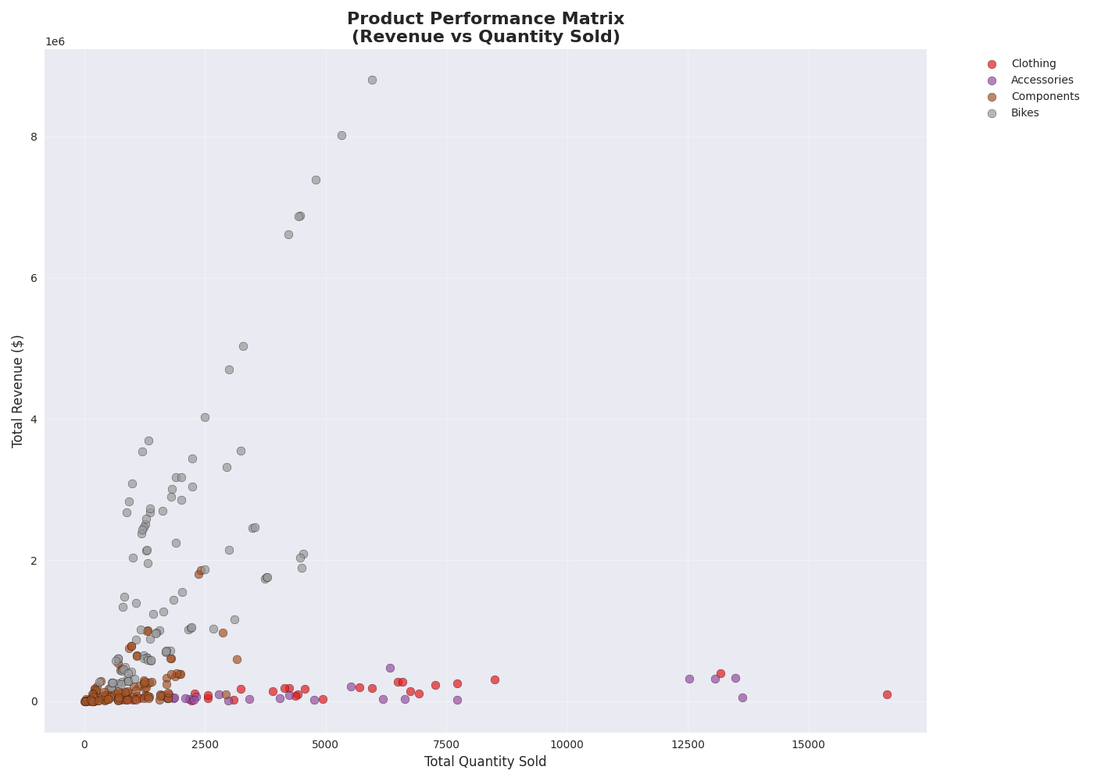
A PICTURE IS WORTH A THOUSAND WORDS

Slide 62
Extra Plots
1
2
3
Monthly Revenue trend
Revenue By Quarter
Territory Performance
5
4
Customer Type Analysis
Product performance Matrix

Slide 63
5
Customer Type Analysis
Customer Type Analysis:
Revenue Share:
SC → 73,3%
IN → 26,7%
Average Order Value
SC → $1,321
IN → $486

Slide 64
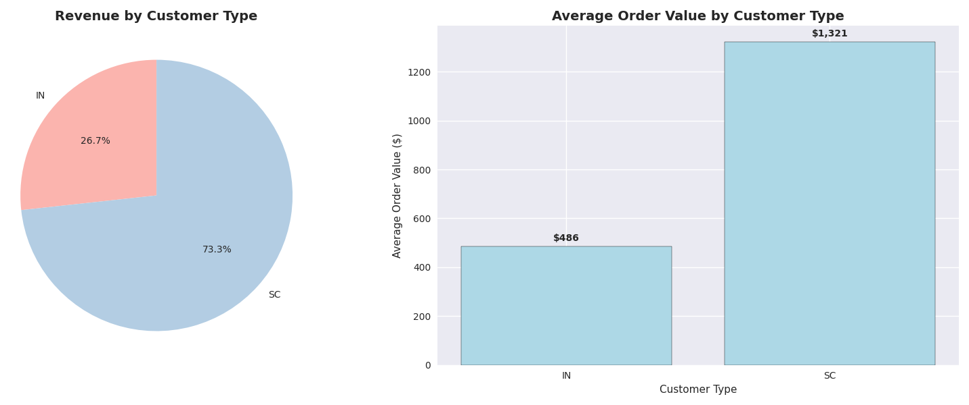
A PICTURE IS WORTH A THOUSAND WORDS

Slide 65
TABLE OF CONTENTS
05
07
06
08
DATA LAYER 3: SILVER LAYER
PROJECT VISUALIZATION
General Information
Approach
Mandatory Plots
Extra Plots
DATA LAYER 4: GOLD LAYER
Findings & Conclusions
General Information
Approach
Reflection (Personal)
Reflection (Team)

Slide 66
08
Findings & Conclusions
Reflection (Personal)
Reflection (Team)

Slide 67
Reflection (Personal)
Jelle Smet
Xander Aerts
Gained a better understanding
Learned to document everything
Gained a better understanding
Gained confidence

Slide 68
TABLE OF CONTENTS
05
07
06
08
DATA LAYER 3: SILVER LAYER
PROJECT VISUALIZATION
General Information
Approach
Mandatory Plots
Extra Plots
DATA LAYER 4: GOLD LAYER
Findings & Conclusions
General Information
Approach
Reflection (Personal)
Reflection (Team)

Slide 69
08
Findings & Conclusions
Reflection (Personal)
Reflection (Team)

Slide 70
Reflection (Team)
Teamwork
Communication
Assistance
Split tasks efficiently
Clear and constant updated
Gii & Github
Helped each other troubleshoot

Slide 71
Data Engineering Final Exam
Questions?
Thomas More
Applied Data Intelligence
Jelle Smet &
Xander Aerts

